Slide 1
Assignment 3: UI Design
Sprint 1 Goal:
Create code that enables searches to the software. Person can enter what they want to see/read and they will be able to receive data from software.

Slide 2
Sitemap
High-level structure

Slide 3
Wireframe
Placement of UI elements

Slide 4
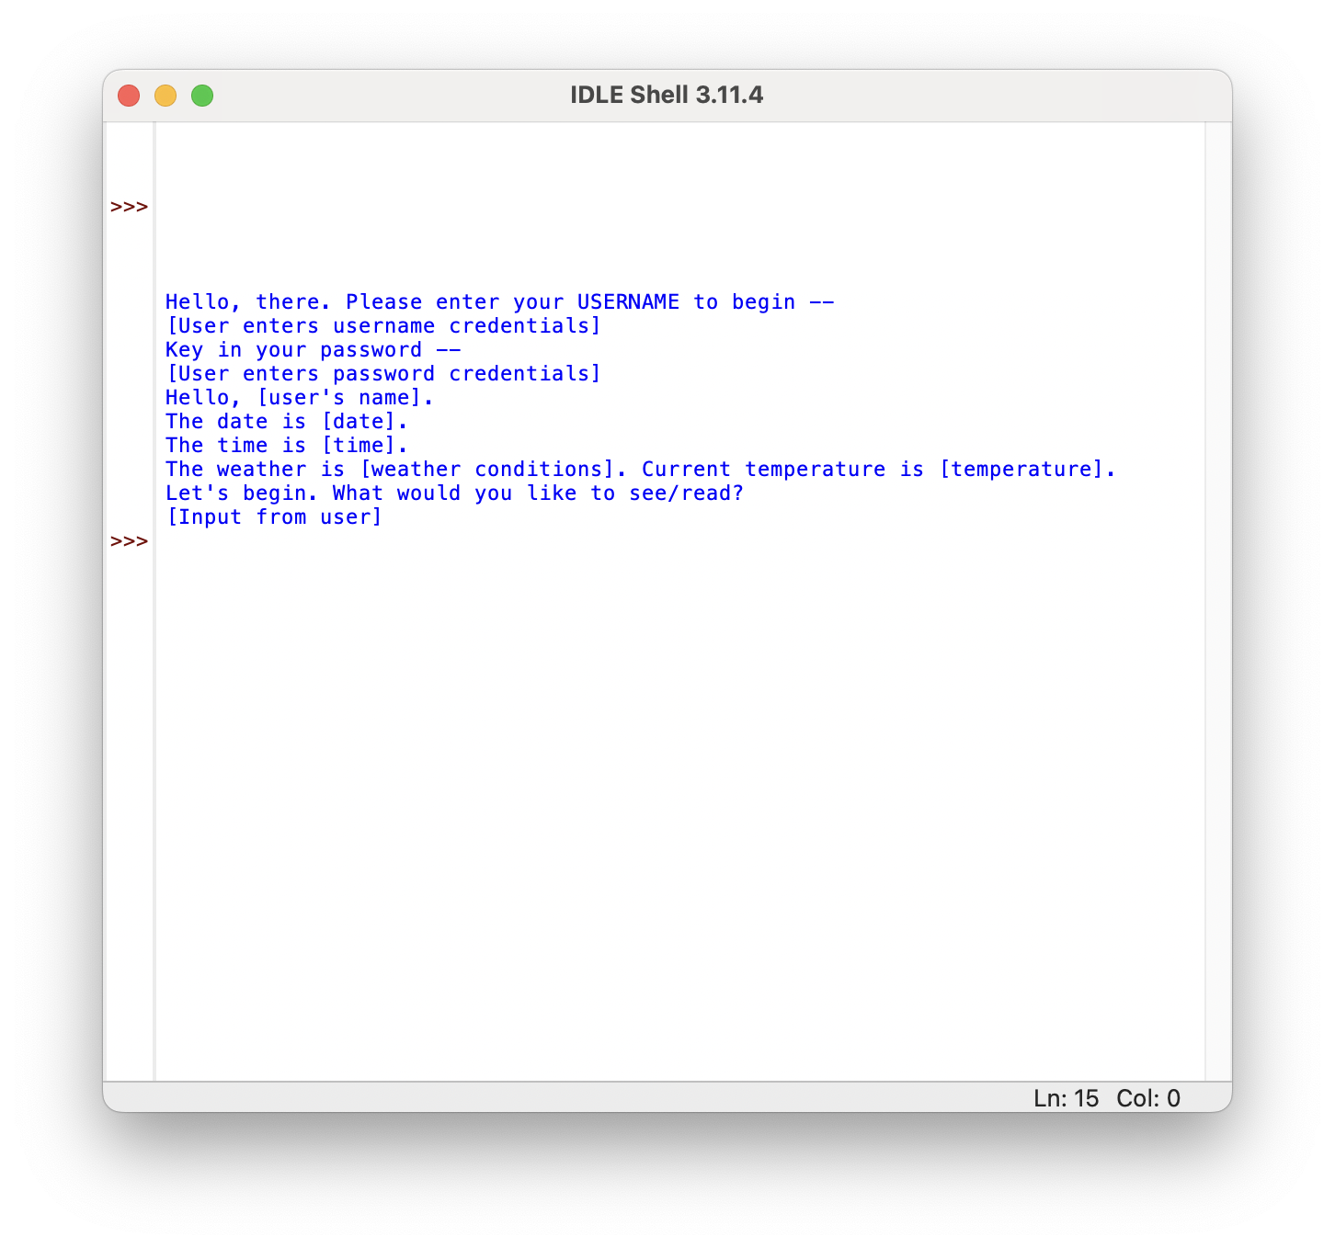
Paper prototype – (1) Greeting User
All the details

Slide 5
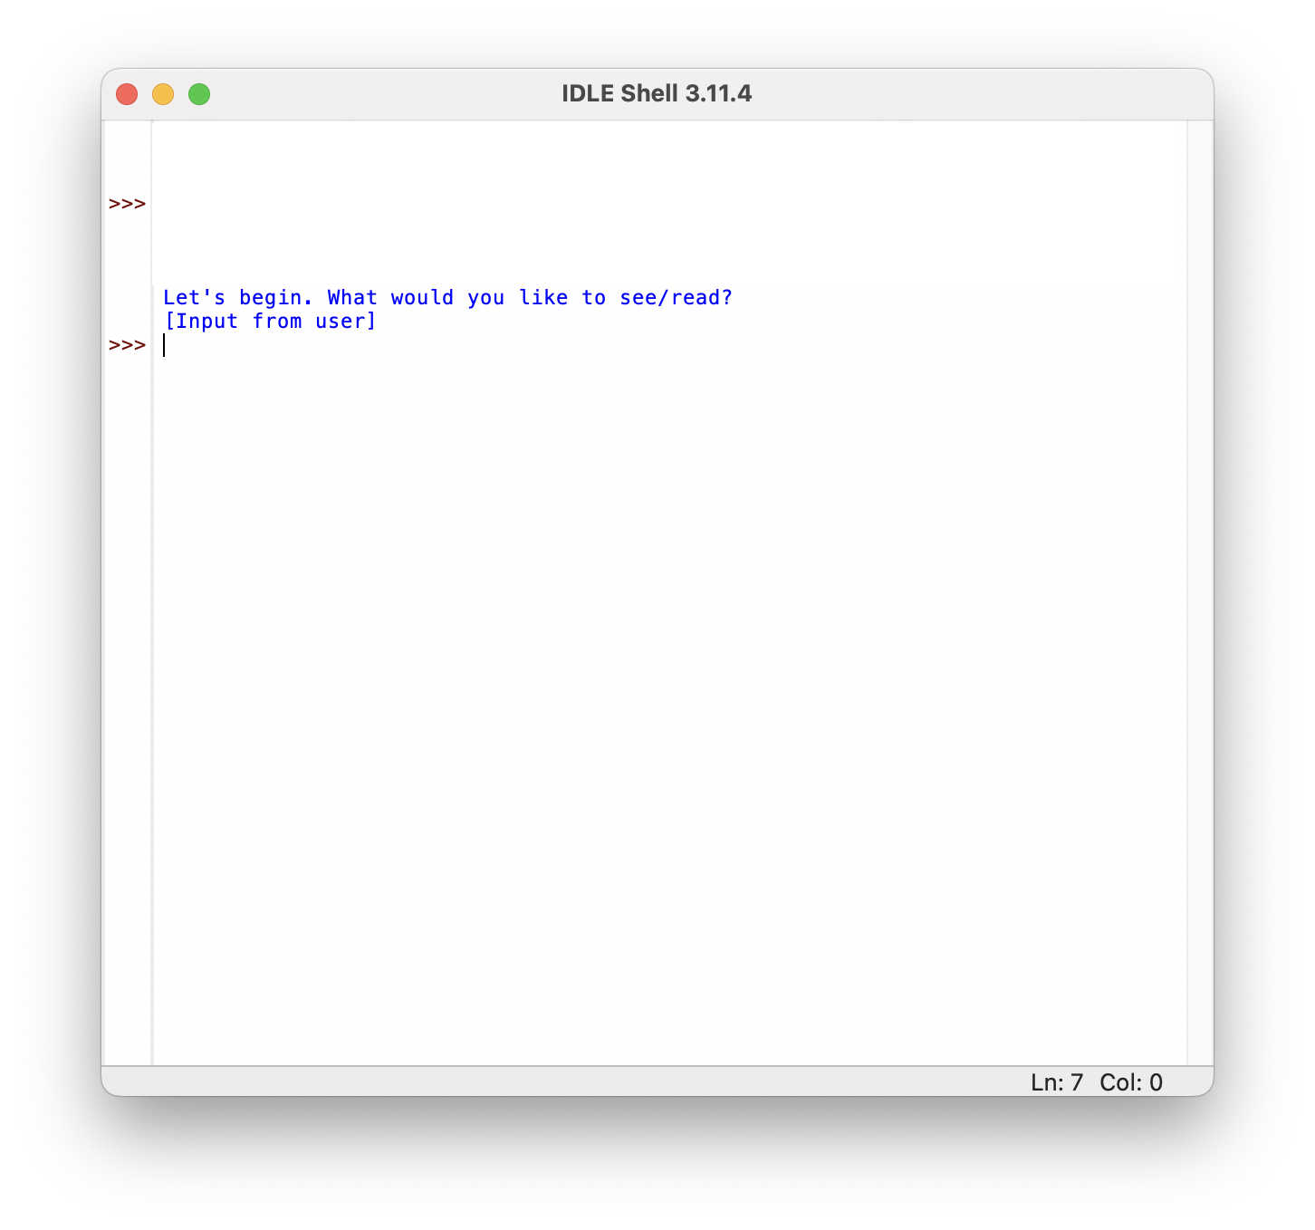
Paper prototype – (2) Portal for Information
All the details

Slide 6
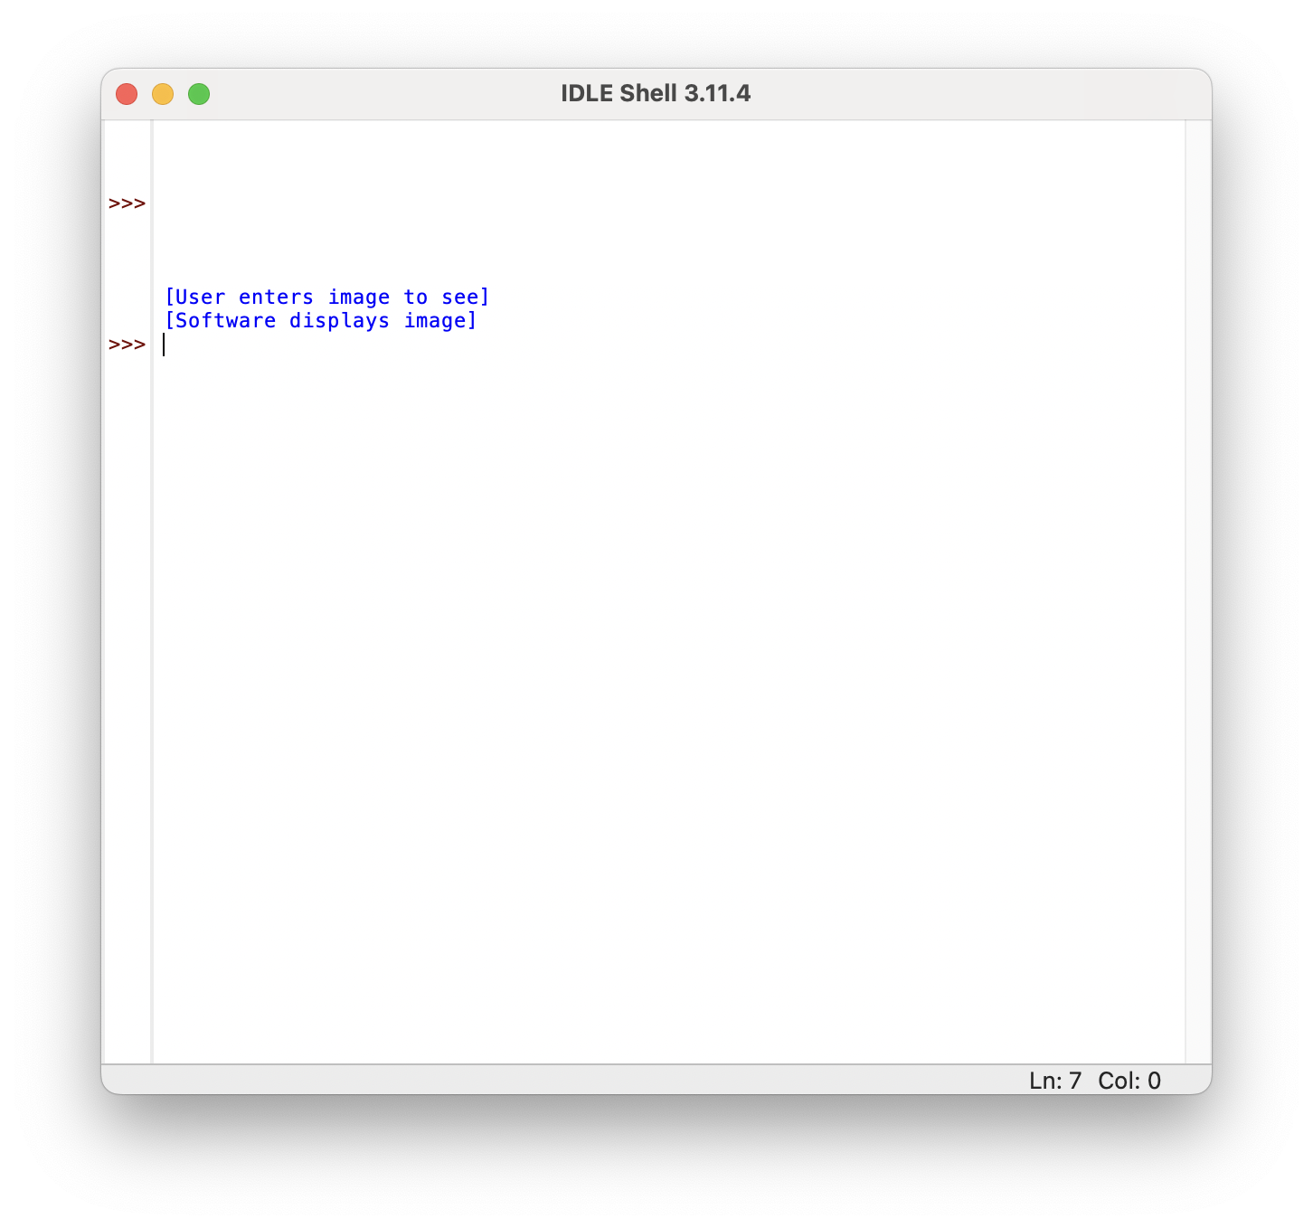
Paper prototype – (3) Generating Picture Page
All the details

Slide 7
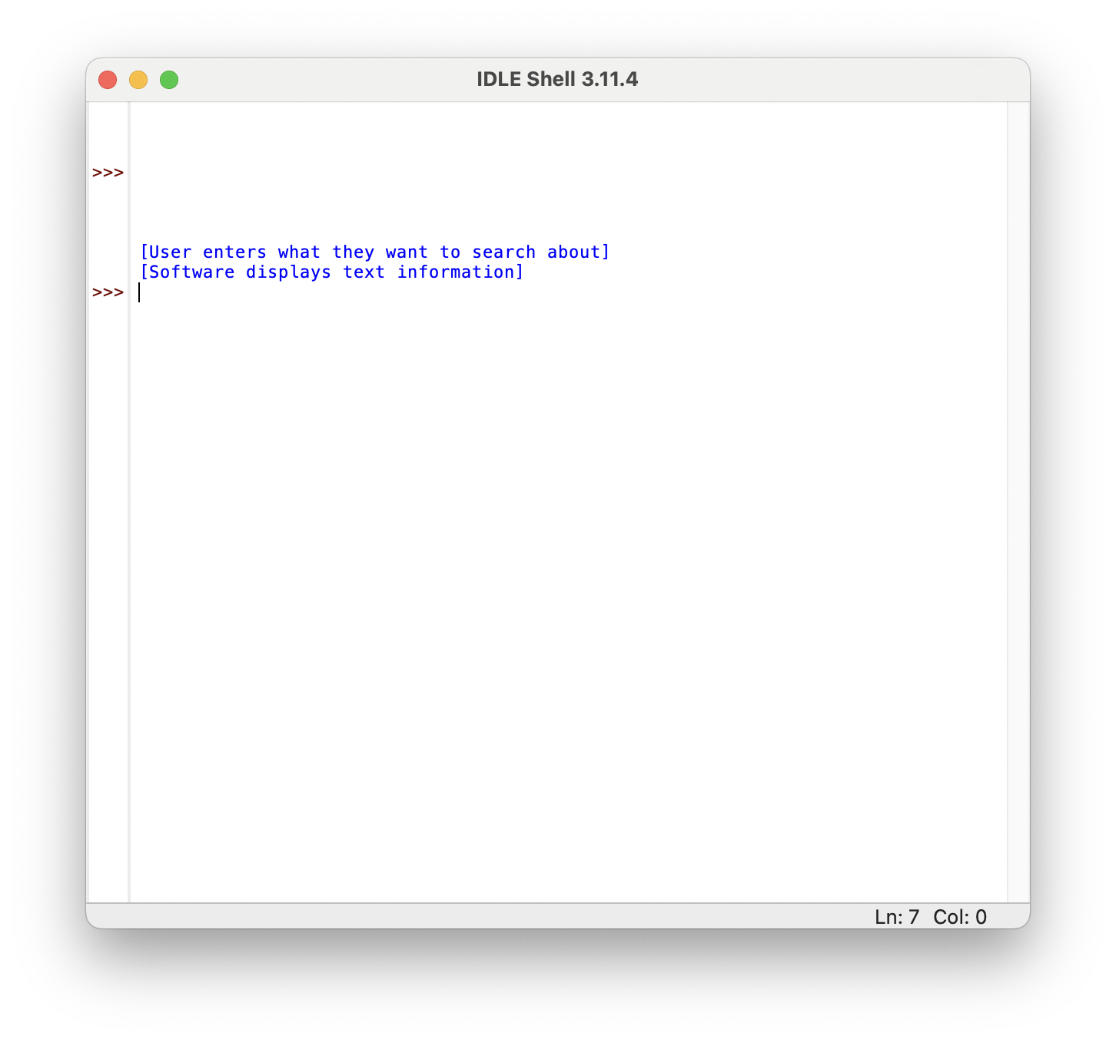
Paper prototype – (4) Generating Text Page
All the details

Slide 8
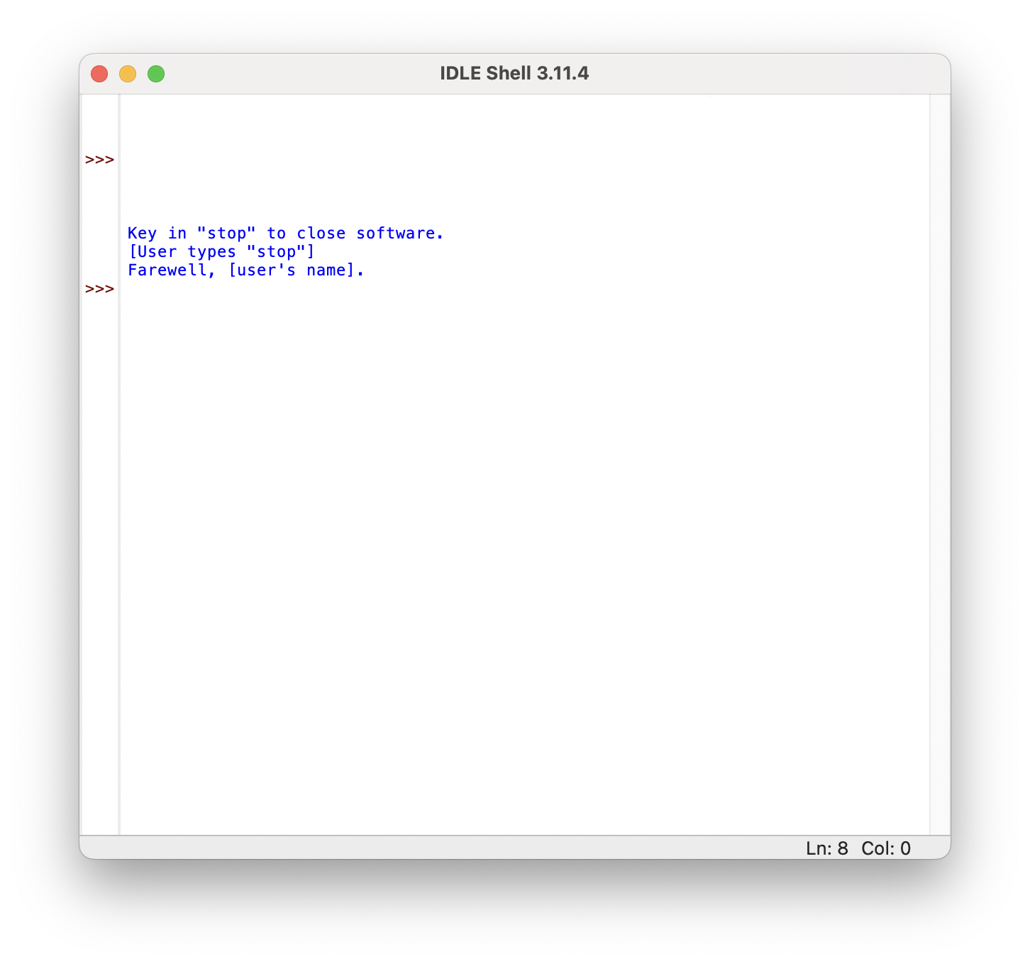
Paper prototype – (5) Farewell to User
All the details

Slide 9
Inclusivity Heuristics Justifications - IH#1
Explain (to Users) the Benefits of Using New and Existing Features
Software explains the purpose of the program in a very simple way. It asks user what to see (image) or read (text) on any topic. Software is intended to mimic an AI interface, so prompts from software is purposefully simple.

Slide 10
Inclusivity Heuristics Justifications - IH#2
Explain (to Users) the Costs of Using New and Existing Features
User is explained that if they enter their username and password, the software will begin initiating as intended.

Slide 11
Inclusivity Heuristics Justifications - IH#3
Let Users Gather as Much Information as They Want, and No More Than They Want
User asks for what image they want to see, and software produces only the relevant image that wants to be seen.

Slide 12
Inclusivity Heuristics Justifications - IH#4
Keep Familiar Features Available
Software will always let user know that they can stop program anytime by “stop.”

Slide 13
Inclusivity Heuristics Justifications - IH#5
Make Undo/Redo and Backtracking Available
Software will always return to this screen after generating image/text, allowing redos. Additionally, returning to this screen automatically undos the last action because software has recycled that prompt.

Slide 14
Inclusivity Heuristics Justifications - IH#6
Provide an Explicit Path through the Task
To use software, user is explicitly commanded to enter username. Afterwards, they are explicitly told to enter password. Finally, they are asked what they want the software to do for them (software usage).

Slide 15
Inclusivity Heuristics Justifications - IH#7
Provide Ways to Try Out Different Approaches
If user wants to know about a specific thing, the user is given the choice to either see a visualization of it or read about it (see vs. read).

Slide 16
Inclusivity Heuristics Justifications - IH#8
Encourage Tinkerers to Tinker Mindfully
Only “stop” will stop the software. Prevents accidental and unwanted suspension of software. Software purposefully restrictive to respect flow of execution.

